Slide 1

EMFACE · EMBODY / EMSCULPT NEO
Google Ads Setup
Proposal
PREPARED FOR
PREPARED BY
Dr Ariel Haus · London Real Skin
Online Marketing for Doctors
Search Advertising · Central London + 5 mi · October 2026

Slide 2




Overview
CAMPAIGN OVERVIEW
Two Devices, Two Audiences
Each device runs as its own focused campaign — separate keywords, copy, targeting and budget. Geo and demographics are set per campaign, not once for the account.
EmBody / EMSCULPT NEO
EmFace
Body · muscle & contour · men and women
Face · lift & tone · needle-free
Geo target
Central London + 5 mi
Geo target
Central London + 5 mi
Demographic
30–55 · all genders
Demographic
30–55 · female-skewed
Daily budget
£40 / day · ≈ £1,216 / mo
Daily budget
£20 / day · ≈ £608 / mo
Ad groups
7 intent-based groups
Ad groups
6 intent-based groups
Combined media budget: £60 / day ≈ £1,824 / month — £40/day EmBody and £20/day EmFace in Phase 1.
London Real Skin · Google Ads Proposal
02

Slide 3

Audience
EMBODY / EMSCULPT NEO · TARGET AUDIENCE
Who We're Speaking To
Two body audiences drive this campaign — both non-surgical, both motivated by muscle tone and definition rather than weight. Every ad group and message maps back to one of these personas.
PERSONA 01
PERSONA 02
The Plateaued Trainer
The Time-Poor Professional
Trains hard · wants definition · 30–50 · men & women
No downtime · 30-minute sessions · 35–55 · city-based
Trains and eats well but has stalled
Wants visible core and limb definition
Sceptical of gimmicks; wants evidence
Attracted to muscle gain, not just contouring
Works in or near the City and Midtown
Will not take recovery time off work
Books around lunch breaks and commutes
Values a clinic, not a high-street salon
“Past the point training reaches.”
“Thirty minutes. No downtime.”
London Real Skin · Google Ads Proposal
03

Slide 4





Persona
PERSONA 01 · EMBODY / EMSCULPT NEO
The Plateaued Trainer
“Past the point training reaches.”
Age 30–50
Men & women
Lifestyle Traits
Goals
Gym or studio 3–5 times a week
Tracks progress and reads the science
Short on time for longer protocols
Already spends on health and training
Visible abdominal and limb definition
Break through a training plateau
Strengthen the core measurably
Results that complement training
Pain Points
Motivators
Effort no longer changes the mirror
Distrust of over-claimed devices
Unsure how many sessions are needed
Worried it is a short-lived result
HIFEM + RF in one 30-minute session
Course of four, 5–10 days apart
Dermatology-led, CQC-regulated clinic
Measured, medically supervised plan
London Real Skin · Google Ads Proposal
04

Slide 5

Persona
PERSONA 02 · EMBODY / EMSCULPT NEO
The Time-Poor Professional
“Thirty minutes. No downtime.”
Age 35–55
City professional
Lifestyle Traits
Goals
Long hours; travels for work
Books treatments near the office
Pays for convenience and discretion
Wants one clear plan, not a hard sell
Visible change without taking leave
Appointments that fit a working day
A predictable course with set dates
A clinic they can trust and return to
Pain Points
Motivators
No time for surgical recovery
Nervous about clinics that oversell
Hard to compare non-surgical options
Needs evening or early appointments
30-minute sessions, no downtime
233 High Holborn — walkable from the City
Dermatology-led and CQC-regulated
Monthly payment options available
London Real Skin · Google Ads Proposal
05

Slide 6
Keywords
EMBODY / EMSCULPT NEO · KEYWORDS & AD GROUPS
Seven Intent-Based Ad Groups
Keywords are grouped by search intent for tighter relevance, higher Quality Scores and lower CPCs. Every keyword runs on Phrase and Exact match only — no broad match in either campaign.
# | Ad Group | Search Intent | KWs | Est. Vol.* | Bid Range
1 | EmSculpt NEO | Branded device terms | 5 | 320 | £1.46–£13.77
2 | Body Sculpting | Core sculpting terms | 7 | 350 | £0.70–£3.08
3 | Body Contouring | Contouring intent | 8 | 140 | £0.80–£2.66
4 | Non-Surgical Body Treatment | Non-surgical intent | 8 | 110 | £0.90–£2.79
5 | Muscle Toning & HIFEM | Muscle-building intent | 4 | 40 | £1.03–£3.52
6 | Treatment Areas | Area-specific intent | 5 | 60 | £0.95–£3.42
7 | Local (Central London) | Local intent | 6 | 60 | est. £1.00–£3.50
* Monthly search estimates from the July 2026 Keyword Planner pull, for relative sizing only. Live Central London volume is a fraction of these.
London Real Skin · Google Ads Proposal
06

Slide 7
Keywords
EMBODY / EMSCULPT NEO · KEYWORDS & AD GROUPS
Full Keyword List & Bids (1 of 2)
1 EmSculpt NEO
3 Body Contouring
4 Non-Surgical Body Treatment
emsculpt neo london
170
H
£1.89–£13.77
body contouring london
70
H
£0.99–£2.38
treatment to reduce fat
40
H
£1.14–£2.79
emsculpt neo near me
110
H
£1.46–£13.75
body contouring treatment
10
M
£0.87–£2.54
noninvasive fat reduction
10
H
£0.97–£1.75
neo emsculpt
20
H
£1.78–£10.88
body contouring treatment near me
10
H
—
non surgery fat reduction
10
H
£1.44–£2.66
emsculpt neo treatment
10
H
—
body contouring clinic near me
10
—
—
non surgery body contouring
10
H
£0.90–£1.88
emsculpt in london
10
—
—
body sculpting skin tightening
10
—
—
body sculpting without surgery
10
—
—
2 Body Sculpting
body contouring non invasive
10
L
—
radio frequency fat reduction
10
H
—
rf body contouring
10
H
£0.80–£2.66
belly fat reduction treatment
10
H
£1.13–£2.19
body sculpting london
140
H
£0.89–£2.36
body contouring packages
10
H
—
skin tightening and fat reduction
10
H
—
sculpting london
140
L
£0.70–£3.08
sculpting treatment
20
H
£1.03–£1.78
the body sculpting
20
L
—
body sculpting treatments near me
10
—
—
body sculpting clinic near me
10
—
—
london body sculpting
10
H
—
London Real Skin · Google Ads Proposal
07

Slide 8
Keywords
EMBODY / EMSCULPT NEO · KEYWORDS & AD GROUPS
Full Keyword List & Bids (2 of 2)
5 Muscle Toning & HIFEM
6 Treatment Areas
7 Local (Central London)
muscle toning treatment
10
H
—
emsculpt arms
20
H
£0.95–£2.26
emsculpt clinic
10
—
—
muscle building treatment
10
—
—
emsculpt neo arms
10
H
£0.99–£3.42
emsculpt neo treatment near me
10
—
—
muscle sculpting treatment
10
—
—
emsculpt thighs
10
H
—
neo emsculpt near me
10
H
—
hifem treatment
10
H
£1.03–£3.52
emsculpt neo abdomen
10
H
—
body shaping clinic near me
10
H
—
love handles treatment
10
H
£1.03–£3.31
body toning treatment near me
10
H
—
sculpt body shaping near me
10
—
—
London Real Skin · Google Ads Proposal
08

Slide 9
Ad Copy
EMBODY / EMSCULPT NEO · AD COPY · SET 1 OF 4
Responsive Search Ad Copy
1
AD GROUP 1 · EmSculpt NEO
2
AD GROUP 2 · Body Sculpting
HEADLINES (15 · ≤30 chars)
HEADLINES (15 · ≤30 chars)
1. EMSCULPT NEO London
2. EMSCULPT NEO Near You
3. Body Sculpting in Holborn
4. 30-Minute Treatments
5. Muscle Toning Treatment
6. No Surgery, No Downtime
7. Dermatology-Led Clinic
8. CQC-Regulated Clinic
9. Course of Four Sessions
10. Central London Clinic
11. Monthly Payment Options
12. Medically Supervised Plan
13. Treats Abs, Arms & Thighs
14. HIFEM + RF In One Session
15. Book a Free Consultation
1. Body Sculpting London
2. Body Sculpting, Holborn
3. Non-Surgical Sculpting
4. 30-Minute Sessions
5. Body Toning Treatment
6. No Surgery, No Downtime
7. Dermatology-Led Clinic
8. CQC-Regulated Clinic
9. Central London Clinic
10. Course of Four Sessions
11. Monthly Payment Options
12. Abs, Arms, Thighs & More
13. Medically Supervised
14. EMSCULPT NEO Technology
15. Book a Free Consultation
DESCRIPTIONS (≤90 chars)
DESCRIPTIONS (≤90 chars)
EMSCULPT NEO at a dermatology-led, CQC-regulated clinic in Holborn. Book a consultation.
A 30-minute treatment that may help tone and strengthen muscle. No surgery, no downtime.
A course of four sessions, planned around you. Monthly payment options available.
Central London clinic, medically supervised. Book your free consultation today.
Non-surgical body sculpting in central London. Dermatology-led and CQC-regulated.
A treatment that may help tone the abdomen, arms and thighs. 30-minute sessions.
A medically supervised course planned at your consultation. No surgery, no downtime.
Book a free body sculpting consultation at our Holborn clinic today.
London Real Skin · Google Ads Proposal
09

Slide 10
Ad Copy
EMBODY / EMSCULPT NEO · AD COPY · SET 2 OF 4
Responsive Search Ad Copy
3
AD GROUP 3 · Body Contouring
4
AD GROUP 4 · Non-Surgical Body Treatment
HEADLINES (15 · ≤30 chars)
HEADLINES (15 · ≤30 chars)
1. Body Contouring London
2. Non-Surgical Contouring
3. Contouring in Holborn
4. Skin Tightening Option
5. 30-Minute Treatments
6. No Surgery, No Downtime
7. Dermatology-Led Clinic
8. CQC-Regulated Clinic
9. Contouring Packages
10. Central London Clinic
11. Monthly Payment Options
12. EMSCULPT NEO & Exion
13. Medically Supervised Plan
14. Treats Abs, Arms & Thighs
15. Book a Free Consultation
1. Non-Surgical Treatment
2. Body Treatment, No Surgery
3. No Needles, No Surgery
4. 30-Minute Treatments
5. Dermatology-Led Clinic
6. CQC-Regulated Clinic
7. Central London Clinic
8. Course of Four Sessions
9. Monthly Payment Options
10. Medically Supervised
11. Skin Tightening Option
12. EMSCULPT NEO Technology
13. Treats Abs, Arms & Thighs
14. Body Toning Treatment
15. Book a Free Consultation
DESCRIPTIONS (≤90 chars)
DESCRIPTIONS (≤90 chars)
Non-surgical body contouring with EMSCULPT NEO and Exion. Central London clinic.
A 30-minute treatment that may help tone and firm. No surgery and no downtime.
Dermatology-led, CQC-regulated care with monthly payment options. Enquire today.
Book a free body contouring consultation at 233 High Holborn. Book now.
A non-surgical option for the body. Dermatology-led clinic in central London.
No surgery, no needles and no downtime. 30-minute medically supervised sessions.
A treatment that may help tone and firm targeted areas. Monthly payment options.
Book a free consultation to see whether the treatment suits you. Enquire now.
London Real Skin · Google Ads Proposal
10

Slide 11
Ad Copy
EMBODY / EMSCULPT NEO · AD COPY · SET 3 OF 4
Responsive Search Ad Copy
5
AD GROUP 5 · Muscle Toning & HIFEM
6
AD GROUP 6 · Treatment Areas
HEADLINES (15 · ≤30 chars)
HEADLINES (15 · ≤30 chars)
1. Muscle Toning Treatment
2. HIFEM Muscle Treatment
3. Core Toning Treatment
4. 30-Minute Sessions
5. Treats Abs, Arms & Thighs
6. No Surgery, No Downtime
7. Dermatology-Led Clinic
8. CQC-Regulated Clinic
9. Central London Clinic
10. Course of Four Sessions
11. Monthly Payment Options
12. EMSCULPT NEO Technology
13. Medically Supervised
14. Body Toning Treatment
15. Book a Free Consultation
1. Arm Toning Treatment
2. Abdomen Toning Treatment
3. Thigh Toning Treatment
4. Treats Flanks & Waist
5. Treats Abs, Arms & Thighs
6. 30-Minute Treatments
7. No Surgery, No Downtime
8. Dermatology-Led Clinic
9. CQC-Regulated Clinic
10. Central London Clinic
11. Course of Four Sessions
12. Monthly Payment Options
13. EMSCULPT NEO Technology
14. Medically Supervised Plan
15. Book a Free Consultation
DESCRIPTIONS (≤90 chars)
DESCRIPTIONS (≤90 chars)
HIFEM muscle toning with EMSCULPT NEO at a dermatology-led clinic in Holborn.
A treatment that may help tone muscle in the abdomen, arms and thighs.
A course of four 30-minute sessions, planned at your medical consultation.
CQC-regulated clinic in central London. Book your free consultation today.
Treat the abdomen, arms, thighs, buttocks or calves with EMSCULPT NEO in Holborn.
Targeted 30-minute sessions with no surgery and no downtime. Book a consultation.
A dermatology-led, CQC-regulated clinic in central London. Monthly payments available.
Book a free consultation to plan the areas and number of sessions you need.
London Real Skin · Google Ads Proposal
11

Slide 12
Ad Copy
EMBODY / EMSCULPT NEO · AD COPY · SET 4 OF 4
Responsive Search Ad Copy
7
AD GROUP 7 · Local (Central London)
HEADLINES (15 · ≤30 chars)
1. Body Sculpting Near You
2. EMSCULPT NEO Near You
3. Holborn Skin Clinic
4. Clinic in Central London
5. 233 High Holborn, WC1V
6. Body Contouring Near You
7. 30-Minute Treatments
8. No Surgery, No Downtime
9. Dermatology-Led Clinic
10. CQC-Regulated Clinic
11. Monthly Payment Options
12. Course of Four Sessions
13. Book a Local Consult
14. Medically Supervised
15. Book a Free Consultation
DESCRIPTIONS (≤90 chars)
Body sculpting at 233 High Holborn, WC1V — minutes from the City and Midtown.
A dermatology-led, CQC-regulated clinic close to the office. Book a local consult.
30-minute sessions with no surgery and no downtime. Monthly payment options.
Book your free consultation at our central London clinic today. Enquire now.
London Real Skin · Google Ads Proposal
12

Slide 13


Protect
CAMPAIGN PROTECTION
Negative Keywords
These exclusions protect budget from weight-loss and GLP-1 traffic, machine buyers, trainees, competitor devices and medical tourism. The full list of 81 broad and 44 phrase negatives is supplied as an importable file.
Broad Match Negatives
81 terms — 27 shown
Phrase Match Negatives
ozempic
mounjaro
wegovy
semaglutide
pill
"weight loss"
"lose weight"
"slimming treatment"
"fat burning"
"fat freezing"
"fat dissolving"
"tummy tuck"
"cosmetic surgery"
"at home"
"how to"
"does it work"
"before and after"
"emsculpt machine"
"vs coolsculpting"
supplement
diet
gym
machine
device
buy
sale
supplier
training
course
jobs
coolsculpting
liposuction
lipo
surgeon
reddit
youtube
tiktok
wikipedia
turkey
abroad
cheap
London Real Skin · Google Ads Proposal
13

Slide 14


Audience
EMFACE · TARGET AUDIENCE
Who We're Speaking To
Two EmFace audiences drive this campaign — both needle-free, both seeking a natural lift rather than an obvious change. Every ad group maps back to one of these personas.
PERSONA 01
PERSONA 02
The Needle-Free Refiner
The Early Intervener
Lift without injectables · 35–55 · mostly female
Preventative · maintain structure · 30–45 · mostly female
Wants lift but not filler or surgery
Worried about looking overfilled or altered
Has tried facials with little lasting change
Drawn to tightening and muscle tone
Starting to notice early laxity
Wants to maintain, not correct later
Prefers a regular maintenance routine
Thinks in years, not single appointments
“Change, without needles.”
“Start early, maintain later.”
London Real Skin · Google Ads Proposal
14

Slide 15

Persona
PERSONA 01 · EMFACE
The Needle-Free Refiner
“Change, without needles.”
Age 35–55
Mostly female
Lifestyle Traits
Goals
Image-aware; on camera for work
Has researched filler and dismissed it
Spends steadily on skincare
Asks what the evidence actually shows
A lifted, rested look that is still hers
Firmer jawline and cheek definition
No needles, no surgery, no downtime
A result that builds over a course
Pain Points
Motivators
Fear of an overdone, filled appearance
Facials that fade within days
Confused by competing device names
Unsure what is safe long term
Tones facial muscle, not just skin
No needles and no downtime
Dermatology-led, CQC-regulated clinic
Consultant-planned course of sessions
London Real Skin · Google Ads Proposal
15

Slide 16

Persona
PERSONA 02 · EMFACE
The Early Intervener
“Start early, maintain later.”
Age 30–45
Preventative
Lifestyle Traits
Goals
Consistent skincare and SPF routine
Follows aesthetic medicine closely
Prefers gradual, unnoticeable change
Budgets for ongoing treatment
Hold facial structure for longer
Avoid needing surgery later
A sustainable maintenance schedule
Subtle change nobody can name
Pain Points
Motivators
Unsure when to start treatment
Does not want to look 'done' at 35
Worried about wasting money too early
Too many conflicting recommendations
Preventative, non-invasive approach
Maintenance sessions after the course
Dermatology-led medical assessment
Combines with Exion and skin protocols
London Real Skin · Google Ads Proposal
16

Slide 17
Keywords
EMFACE · KEYWORDS & AD GROUPS
Six Intent-Based Ad Groups
EmFace is a newer term with less established volume, so the campaign is built around non-surgical lifting, skin tightening and jawline intent alongside the branded terms. Phrase and Exact match only.
# | Ad Group | Search Intent | KWs | Est. Vol.* | Bid Range
1 | EmFace | Branded device terms | 8 | 2,440 | £0.90–£6.00
2 | Non-Surgical Facelift | Primary non-surgical intent | 6 | 1,830 | £1.20–£6.50
3 | Facial Skin Tightening | Tightening & collagen intent | 8 | 2,240 | £0.80–£4.50
4 | Jawline & Jowls | Area-specific intent | 8 | 1,460 | £0.90–£4.00
5 | Facial Muscle Toning | USP-led · HIFES | 7 | 670 | £0.70–£3.60
6 | Local (Central London) | Local intent | 5 | 770 | £1.30–£5.40
* EmFace volumes are estimates pending a live Keyword Planner pull; branded device demand is still building in the UK.
London Real Skin · Google Ads Proposal
17

Slide 18
Keywords
EMFACE · KEYWORDS & AD GROUPS
Full Keyword List & Bids
1 EmFace
3 Facial Skin Tightening
5 Facial Muscle Toning
emface
1,900
H
£1.20–£4.50
skin tightening face
880
H
£0.90–£3.00
face lifting treatment
390
H
£1.10–£3.60
emface london
170
H
£1.80–£6.00
face tightening treatment
480
H
£1.00–£3.20
facial muscle toning
90
M
£0.90–£3.00
emface near me
110
H
£1.60–£5.50
skin tightening london
320
H
£1.40–£4.50
facial toning treatment
70
M
£0.85–£2.90
emface treatment
90
H
£1.20–£4.00
facial skin tightening
210
H
£0.95–£3.10
natural facelift treatment
50
M
£1.00–£3.20
emface cost
70
M
£0.90–£3.00
skin tightening treatment near me
170
H
£1.30–£4.00
lift and tone face
30
M
£0.80–£2.70
emface price
50
M
£0.90–£3.00
radiofrequency facial london
90
M
£1.10–£3.40
hifes facial
20
L
£0.80–£2.50
emface facial
30
M
£1.00–£3.50
collagen stimulating facial
50
M
£0.80–£2.60
facial muscle stimulation
20
L
£0.70–£2.40
btl emface
20
M
£1.00–£3.50
face firming treatment
40
M
£0.85–£2.80
6 Local (Central London)
2 Non-Surgical Facelift
4 Jawline & Jowls
face treatment london
320
H
£1.30–£4.20
non surgical facelift
1,300
H
£1.50–£5.00
jawline treatment
480
H
£1.20–£4.00
facial clinic london
210
H
£1.50–£5.00
non surgical face lift london
170
H
£2.00–£6.50
jowls treatment
320
H
£1.00–£3.50
skin clinic central london
170
H
£1.60–£5.20
facelift without surgery
140
H
£1.30–£4.20
jawline contouring
260
H
£1.10–£3.80
non surgical facelift clinic near me
50
H
£1.70–£5.40
non surgical facelift near me
110
H
£1.80–£5.50
sagging jowls treatment
170
H
£1.00–£3.40
emface clinic london
20
M
£1.50–£5.00
non invasive facelift
70
H
£1.40–£4.00
non surgical jawline
90
M
£1.20–£3.90
non surgical face lifting treatment
40
M
£1.20–£3.80
define jawline treatment
70
M
£1.00–£3.20
cheek lift non surgical
40
M
£1.10–£3.50
midface lift non surgical
30
L
£0.90–£3.00
London Real Skin · Google Ads Proposal
18

Slide 19
Ad Copy
EMFACE · AD COPY · SET 1 OF 3
Responsive Search Ad Copy
1
AD GROUP 1 · EmFace
2
AD GROUP 2 · Non-Surgical Facelift
HEADLINES (15 · ≤30 chars)
HEADLINES (15 · ≤30 chars)
1. EmFace in London
2. EmFace Near You
3. EmFace at Our Holborn Clinic
4. Needle-Free Treatment
5. Facial Toning Treatment
6. 20-Minute Sessions
7. No Needles, No Downtime
8. Dermatology-Led Clinic
9. CQC-Regulated Clinic
10. Central London Clinic
11. Course of Four Sessions
12. Monthly Payment Options
13. Medically Supervised Plan
14. Non-Surgical Treatment
15. Book a Free Consultation
1. Non-Surgical Face Treatment
2. Face Treatment, No Surgery
3. Needle-Free Treatment
4. No Surgery, No Downtime
5. EmFace in London
6. Facial Toning Treatment
7. 20-Minute Sessions
8. Dermatology-Led Clinic
9. CQC-Regulated Clinic
10. Central London Clinic
11. Course of Four Sessions
12. Monthly Payment Options
13. Medically Supervised
14. Non-Surgical Option
15. Book a Free Consultation
DESCRIPTIONS (≤90 chars)
DESCRIPTIONS (≤90 chars)
EmFace at a dermatology-led, CQC-regulated clinic in central London. Book a consult.
A 20-minute treatment that may help lift and tone the face. No needles, no surgery.
A course planned at your medical consultation. Monthly payment options available.
Book your free EmFace consultation at 233 High Holborn, WC1V. Enquire today.
A non-surgical approach to the face. Dermatology-led clinic in central London.
No surgery, no needles and no downtime — 20-minute sessions in central London.
EmFace works on facial muscle as well as skin and may help lift and tone.
Book a free consultation to find out whether EmFace suits you. Enquire now.
London Real Skin · Google Ads Proposal
19

Slide 20
Ad Copy
EMFACE · AD COPY · SET 2 OF 3
Responsive Search Ad Copy
3
AD GROUP 3 · Facial Skin Tightening
4
AD GROUP 4 · Jawline & Jowls
HEADLINES (15 · ≤30 chars)
HEADLINES (15 · ≤30 chars)
1. Facial Skin Treatment
2. Skin Tightening London
3. Skin Firming Treatment
4. Radiofrequency Facial
5. No Needles, No Downtime
6. 20-Minute Sessions
7. Dermatology-Led Clinic
8. CQC-Regulated Clinic
9. Central London Clinic
10. EmFace & Exion Available
11. Course of Four Sessions
12. Monthly Payment Options
13. Medically Supervised
14. Non-Surgical Treatment
15. Book a Free Consultation
1. Jawline Treatment London
2. Jawline Contouring
3. Treatment for Jowls
4. Lower Face Treatment
5. Non-Surgical Jawline
6. Needle-Free Treatment
7. EmFace in London
8. 20-Minute Sessions
9. No Needles, No Downtime
10. Dermatology-Led Clinic
11. CQC-Regulated Clinic
12. Central London Clinic
13. Course of Four Sessions
14. Monthly Payment Options
15. Book a Free Consultation
DESCRIPTIONS (≤90 chars)
DESCRIPTIONS (≤90 chars)
Facial skin treatments with EmFace and Exion at a dermatology-led Holborn clinic.
Radiofrequency that may help firm the skin and tone facial muscle. No needles.
A course planned at your consultation, with monthly payment options available.
Book a free skin tightening consultation in central London today. Enquire now.
Non-surgical jawline and jowl treatment with EmFace. Dermatology-led Holborn clinic.
A treatment that may help lift and define the lower face. No needles, no surgery.
A course of 20-minute sessions, planned at your medical consultation. Enquire today.
Book a free consultation at our CQC-regulated central London clinic. Book now.
London Real Skin · Google Ads Proposal
20

Slide 21
Ad Copy
EMFACE · AD COPY · SET 3 OF 3
Responsive Search Ad Copy
5
AD GROUP 5 · Facial Muscle Toning
6
AD GROUP 6 · Local (Central London)
HEADLINES (15 · ≤30 chars)
HEADLINES (15 · ≤30 chars)
1. Facial Toning Treatment
2. Facial Muscle Treatment
3. Face Treatment, London
4. Needle-Free Treatment
5. EmFace in London
6. 20-Minute Sessions
7. No Needles, No Downtime
8. Non-Surgical Treatment
9. Dermatology-Led Clinic
10. CQC-Regulated Clinic
11. Central London Clinic
12. Course of Four Sessions
13. Monthly Payment Options
14. Medically Supervised
15. Book a Free Consultation
1. EmFace Near You
2. Facial Clinic in London
3. Holborn Skin Clinic
4. 233 High Holborn, WC1V
5. Skin Clinic Near the City
6. Needle-Free Treatment
7. 20-Minute Sessions
8. No Needles, No Downtime
9. Dermatology-Led Clinic
10. CQC-Regulated Clinic
11. Book a Local Consult
12. Course of Four Sessions
13. Monthly Payment Options
14. Non-Surgical Treatment
15. Book a Free Consultation
DESCRIPTIONS (≤90 chars)
DESCRIPTIONS (≤90 chars)
EmFace works on the facial muscles as well as the skin — no needles, no downtime.
A 20-minute treatment that may help lift and tone. Central London clinic.
Dermatology-led and CQC-regulated, with monthly payment options available.
Book a free consultation to plan your course of treatment. Enquire today.
EmFace at 233 High Holborn, WC1V — a dermatology-led clinic minutes from the City.
A needle-free facial treatment close to the office. Book a local consult.
20-minute sessions with no downtime. CQC-regulated and medically supervised.
Book your free consultation at our central London skin clinic today.
London Real Skin · Google Ads Proposal
21

Slide 22
Protect
CAMPAIGN PROTECTION
Negative Keywords
These exclusions keep EmFace spend away from injectables, thread lifts, surgical facelift traffic, competitor devices, DIY face-exercise searches and machine buyers. The full list of 74 broad and 39 phrase negatives is supplied as an importable file.
Broad Match Negatives
74 terms — 24 shown
Phrase Match Negatives
botox
filler
fillers
thread
threadlift
"thread lift"
"mini facelift"
"ponytail facelift"
"liquid facelift"
"facelift surgery"
"deep plane"
"face yoga"
"face exercises"
"facial massage"
"anti wrinkle injections"
"dermal filler"
"at home"
"how to"
"does it work"
"emface machine"
surgeon
hifu
ultherapy
morpheus8
profhilo
machine
device
buy
training
course
jobs
reddit
youtube
tiktok
wikipedia
turkey
abroad
cheap
massage
London Real Skin · Google Ads Proposal
22

Slide 23



PMax
PHASE 2 · PERFORMANCE MAX
Performance Max — Asset Groups
Once Search is delivering, we layer in Performance Max to reach qualified prospects across YouTube, Discover, Gmail, Maps and Display. Each device runs as its own PMax campaign, with two asset groups — one per persona.
EmBody / EMSCULPT NEO
2 asset groups
EmFace
2 asset groups
ASSET GROUP A
ASSET GROUP A
Plateaued Trainer
Needle-Free Refiner
Muscle tone · evidence-led · training plateau
Needle-free · facial muscle tone · no downtime
ASSET GROUP B
ASSET GROUP B
Time-Poor Professional
Early Intervener
No downtime · 30 minutes · Holborn location
Preventative · maintenance · long-term plan
Asset Checklist (per group)
Creative Compliance
15 headlines (≤30) · 5 long (≤90) · 5 descriptions · images 1.91:1, 1:1 & 4:5 (+ logos) · 1+ YouTube video · CTA: Book Now
No outcome claims — 'may help' language only · no before/after as primary creative · no Customer Match or similar lists (health) · written consent for images
London Real Skin · Google Ads Proposal
23

Slide 24
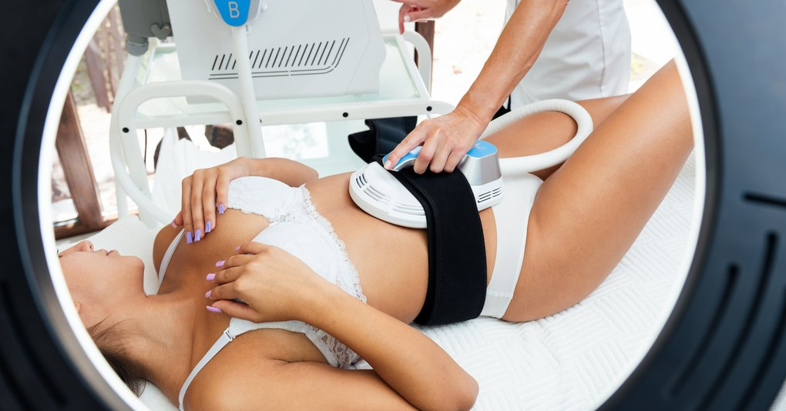
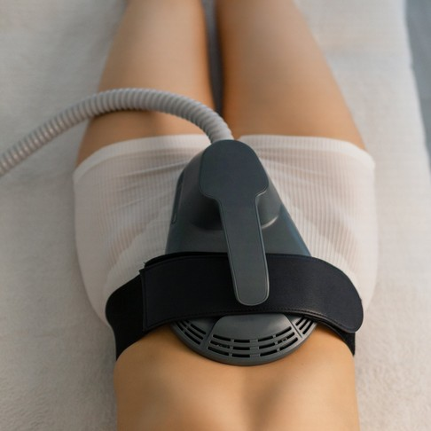
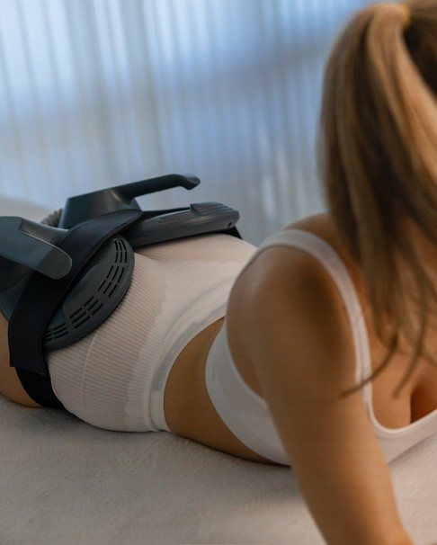


Asset Group
PERFORMANCE MAX · ASSET GROUP A (EMBODY)
Plateaued Trainer
CREATIVE ASSETS — stock models, safe-zone cropped
RESPONSIVE PMAX COPY
SHORT HEADLINES (≤30)
Muscle Toning Treatment
EMSCULPT NEO London
30-Minute Sessions
Non-Surgical Treatment
No Surgery, No Downtime
Dermatology-Led Clinic
Treats Abs, Arms & Thighs
Book a Free Consultation
1:1
1.91:1
LONG HEADLINES (≤90)
VIDEO 16:9 · YouTube
EMSCULPT NEO at a dermatology-led clinic in central London.
A 30-minute session that may help tone and strengthen muscle.
A medically supervised course of four, planned around your training.
15–30s: clinician introduction, how HIFEM + RF works, 30-minute session walk-through, soft CTA 'Book a consultation'. Calm, clinical, credible tone.
DESCRIPTIONS (≤90)
Training support, in 30 minutes. Book today.
A 30-minute treatment that may help tone muscle. Book a Holborn consult.
Dermatology-led and CQC-regulated. Book your free consultation.
4:5
Audience Signals
Business: London Real Skin CTA: Book Now
Search themes: emsculpt neo, body sculpting, muscle toning
In-market: fitness & wellness, beauty services
Demographics: 30–50, all genders, central London + 5 mi
London Real Skin · Google Ads Proposal
24

Slide 25
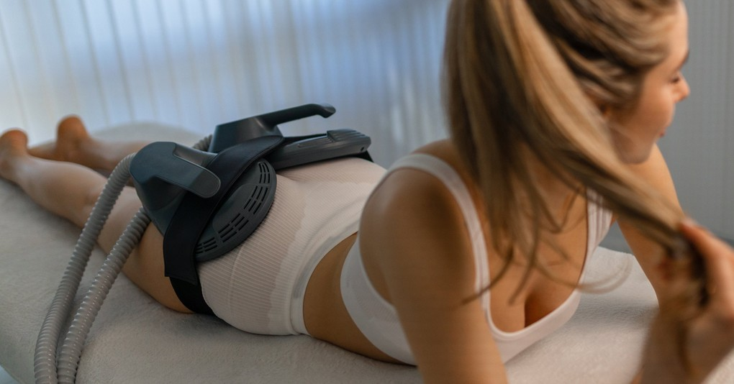
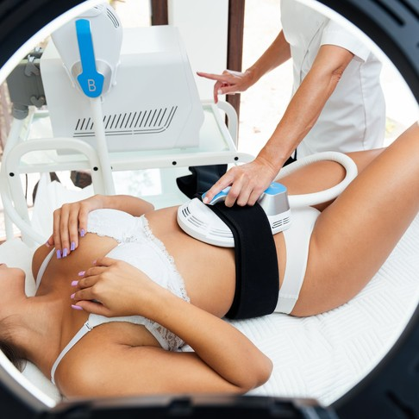
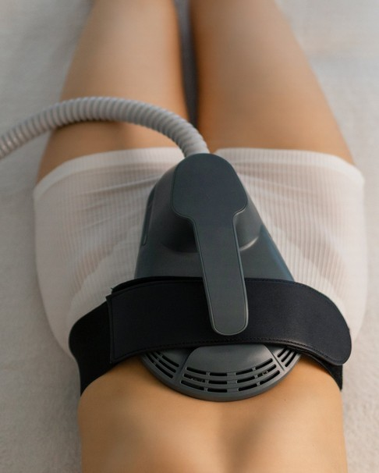
Asset Group
PERFORMANCE MAX · ASSET GROUP B (EMBODY)
Time-Poor Professional
CREATIVE ASSETS — stock models, safe-zone cropped
RESPONSIVE PMAX COPY
SHORT HEADLINES (≤30)
Thirty Minutes, No Downtime
Body Sculpting, Holborn
Clinic Near the City
CQC-Regulated Clinic
Monthly Payment Options
Non-Surgical Contouring
Medically Supervised
Book a Free Consultation
1:1
1.91:1
LONG HEADLINES (≤90)
VIDEO 16:9 · YouTube
Body sculpting that fits a working day — 30 minutes, no downtime.
A CQC-regulated clinic at 233 High Holborn, minutes from the City.
Medically supervised plans with monthly payment options available.
15–30s: clinic interior, convenience of the Holborn location, 30-minute session, CTA 'Book a consultation'. Premium, reassuring, professional tone.
DESCRIPTIONS (≤90)
Thirty minutes. No downtime. Book today.
A dermatology-led clinic close to the office. Book a local consult.
Monthly payment options available. Book your free consultation.
4:5
Audience Signals
Business: London Real Skin CTA: Book Now
Search themes: body contouring london, body sculpting near me
In-market: beauty & personal care services
Demographics: 35–55, all genders, central London + 5 mi
London Real Skin · Google Ads Proposal
25

Slide 26



Asset Group
PERFORMANCE MAX · ASSET GROUP A (EMFACE)
Needle-Free Refiner
CREATIVE ASSETS — stock models, safe-zone cropped
RESPONSIVE PMAX COPY
SHORT HEADLINES (≤30)
Needle-Free Treatment
EmFace in London
Facial Toning Treatment
20-Minute Sessions
No Needles, No Downtime
Dermatology-Led Clinic
Non-Surgical Treatment
Book a Free Consultation
1:1
1.91:1
LONG HEADLINES (≤90)
VIDEO 16:9 · YouTube
A needle-free facial treatment at a dermatology-led London clinic.
EmFace works on facial muscle as well as skin — no downtime.
A dermatology-led, CQC-regulated clinic at 233 High Holborn.
15–30s: clinician explains facial muscle toning, needle-free message, 20-minute session, CTA 'Book a consultation'. Warm, premium, reassuring tone.
DESCRIPTIONS (≤90)
Needle-free, no downtime. Book today.
A 20-minute treatment that may help lift and tone. Book a consult.
Dermatology-led and CQC-regulated. Book your free consultation.
4:5
Audience Signals
Business: London Real Skin CTA: Book Now
Search themes: emface, non surgical facelift, skin tightening
In-market: beauty services, skin care
Demographics: 35–55, female-skewed, central London + 5 mi
London Real Skin · Google Ads Proposal
26

Slide 27


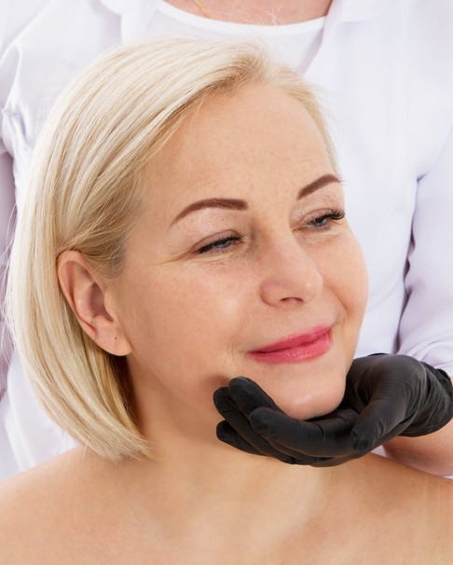
Asset Group
PERFORMANCE MAX · ASSET GROUP B (EMFACE)
Early Intervener
CREATIVE ASSETS — stock models, safe-zone cropped
RESPONSIVE PMAX COPY
SHORT HEADLINES (≤30)
Start Before You Need To
Preventative Face Toning
EmFace in London
Maintenance Plans Available
No Needles, No Downtime
Dermatology-Led Clinic
Central London Clinic
Book a Free Consultation
1:1
1.91:1
LONG HEADLINES (≤90)
VIDEO 16:9 · YouTube
A preventative, needle-free treatment with a planned maintenance schedule.
Dermatology-led assessment and a maintenance plan built around you.
EmFace and Exion protocols at a CQC-regulated central London clinic.
15–30s: preventative-care message, consultation and planning, maintenance schedule, CTA 'Book a consultation'. Considered, medical, understated tone.
DESCRIPTIONS (≤90)
A preventative plan. Book today.
A preventative plan from a dermatology-led clinic. Book a consult.
Maintenance sessions after your course. Book a free consultation.
4:5
Audience Signals
Business: London Real Skin CTA: Book Now
Search themes: facial toning, skin tightening, jawline treatment
In-market: skin care & beauty services
Demographics: 30–45, female-skewed, central London + 5 mi
London Real Skin · Google Ads Proposal
27

Slide 28



Budget
INVESTMENT
Media Budget & Phasing
Split by opportunity: £40 / day EmBody · £20 / day EmFace — each runs as its own campaign.
Phase 1 — Search first
£60
The combined £60/day launches on Google Search, profiled per device, while we gather conversion data, refine keywords and build Quality Score.
Phase 2 — Scale what works
per day · combined
As Search gains momentum we introduce Performance Max from Month 4 with incremental budget, expanding reach across Google's inventory.
≈ £420 / week
≈ £1,824 / month total budget
Flexible reallocation
Budget can be shifted between Search, PMax and the two devices to chase the strongest cost per enquiry.
London Real Skin · Google Ads Proposal
28

Slide 29




Setup
IMPLEMENTATION
Search Campaign Setup Checklist
Campaigns: OMD – Search – EmBody / EMSCULPT NEO · OMD – Search – EmFace
1 · New Campaign
2 · Campaign Settings
Goal: Leads
Type: Search
One campaign per device
Networks: uncheck Display & Search partners
Location: Central London + 5 mi
Presence: people in / regularly in location
Language: English · Budget: £40 and £20/day
AI Max OFF · Bidding: Maximise Conversions
3 · Ad Groups & Keywords
4 · Ad Extensions & Devices
Match types: Phrase and Exact
7 groups EmBody · 6 groups EmFace
Apply per-campaign negative lists
Sitelinks · Callouts · Structured snippets
Call extension (020 7183 5892)
Logo · Business name: London Real Skin
Target device: All — optimise once data lands
London Real Skin · Google Ads Proposal
29

Slide 30




Extensions
ASSETS & SETUP
Ad Extensions & Devices
Ad assets expand ads with extra links, info and calls to action — lifting CTR and Ad Rank at no extra cost. Add every relevant asset at campaign level, per device.
Sitelinks
Callouts
Call Extension
EMSCULPT NEO · EmFace
Prices & Packages
Monthly Payment Options
About the Clinic
Book a Free Consultation
Dermatology-led clinic
CQC-regulated
No surgery, no downtime
30-minute sessions
Monthly payment options
Add 020 7183 5892
Turn on call reporting
Schedule to clinic hours
Click-to-call on mobile
Structured Snippets
Location & Images
Devices & Notes
Header: Services
EMSCULPT NEO · EmFace
Body contouring · Skin tightening
Exion · RF treatments
Free consultation
Link Google Business Profile
233 High Holborn, WC1V 7DN
Add clinic & treatment images
No before/after as primary (policy)
Consider a lead-form asset
Start all devices; adjust with data
Mobile: high call intent — fast LP
Automated bidding sets device bids
Assets are free — add all relevant
Landing pages: /treatments/emsculpt-neo-london/ · /treatments/body-contouring-with-skin-tightening-london/ · EmFace page required before launch (URL TBC)
London Real Skin · Google Ads Proposal
30

Slide 31

Roadmap
GROWTH PLAN
6-Month Optimisation Roadmap
A focused six-month engagement. Search launches first to gather data and build Quality Score; we then test landing pages, layer in Performance Max from Month 4, scale the winners and review — reallocating budget toward the lowest cost per enquiry throughout.
MONTH 1
MONTH 2
MONTH 3
MONTH 4
MONTH 5
MONTH 6
Launch & Track
Refine Search
Test & Optimise
Launch PMax
Scale What Works
Review & Plan Ahead
Go live on Search (Phrase + Exact)
Install conversion & call tracking
Set baseline cost per enquiry
Mine search terms; expand negatives
Tune bids, schedules & radius
Build Quality Score to cut CPCs
A/B test landing pages & CTAs
Rotate RSA headline assets
Review enquiry quality with clinic
Add PMax + four asset groups
Feed Search conversion data in
Google audience signals only
Add winning keywords & ad groups
Shift budget to best cost per enquiry
Expand strongest treatment areas
Full ROI & cost-per-enquiry review
Scale winners, cut waste
Agree next-phase growth plan
London Real Skin · Google Ads Proposal
31

Slide 32
Forecast
FORECAST
Expected Clicks, Enquiries & Cost
Per-campaign projection — EmBody at £40/day (≈ £1,216/month) and EmFace at £20/day (≈ £608/month). Figures are illustrative; Central London volume means spend and clicks will ramp over the first weeks.
EmBody / EMSCULPT NEO · £40/day
EmFace · £20/day
Metric | Cons. | Expected | Opt.
Avg. CPC (GBP) | £3.20 | £2.70 | £2.20
Monthly clicks | ~380 | ~450 | ~553
Click → enquiry | 3% | 4% | 5%
Monthly enquiries | ~11 | ~18 | ~28
Cost per enquiry | £111 | £68 | £43
Metric | Cons. | Expected | Opt.
Avg. CPC (GBP) | £3.00 | £2.50 | £2.00
Monthly clicks | ~203 | ~243 | ~304
Click → enquiry | 3% | 4% | 5%
Monthly enquiries | ~6 | ~10 | ~15
Cost per enquiry | £101 | £61 | £41
Projected monthly enquiries
Projected monthly enquiries
Why the maths works: a four-session EMSCULPT NEO course is £1,400–£4,000. Converting even a handful of the ~28 combined monthly enquiries returns several times the £1,824 monthly spend. Focus is enquiry quality, not clicks.
32

Slide 33



READY TO LAUNCH
Let's fill the consultation diary.
On approval we build both campaigns to the checklist above, install conversion and call tracking, and report on enquiries, cost per enquiry and consultations booked — per device.
onlinemarketingfordoctors.com
+44 20 4572 2823
19 Portland Pl, London W1B 1PX
Online Marketing for Doctors · Prepared for Dr Ariel Haus · London Real Skin · October 2026

